Slide 1
Outcome Assessment
Susan Perry
University Director of Outcome Assessment
Faculty Senate
March 31, 2014

Slide 2
Outcome Assessment
Outcome assessment measures the degree to which the following statement is true:
“As a result of the successful completion of ___(program coursework, co-curricular experiences or other learning activities)___ a student will be able to __(learning outcomes)___.”
This information is systematically collected, reviewed, and used to improve student learning.

Slide 3
Ongoing assessment activities
Communication & collaboration
Outcome Assessment Coordinating Committee
Professional development
Workshops
Tools
Blackboard Outcomes & Surveys
Website
UCITE sessions
E-portfolio
Other committees and offices
Assessment guide
Meetings
Grant applications
Google site

Slide 4
Communication and collaboration
Outcome Assessment Coordinating Committee
  Jaime Bouvier (School of Law)
  Jennifer Johnson (Weatherhead School of Management)
  Peter Lagerlof (Case School of Engineering)
  Lynn Lotas (Frances Payne Bolton School of Nursing)
  Megan McNamara (School of Medicine)
  Mano Singham (UCITE)
  Kristin Victoroff (School of Dental Medicine)
  Peter Whiting (College of Arts and Sciences)
  Zoe Wood (MSASS)

Slide 5
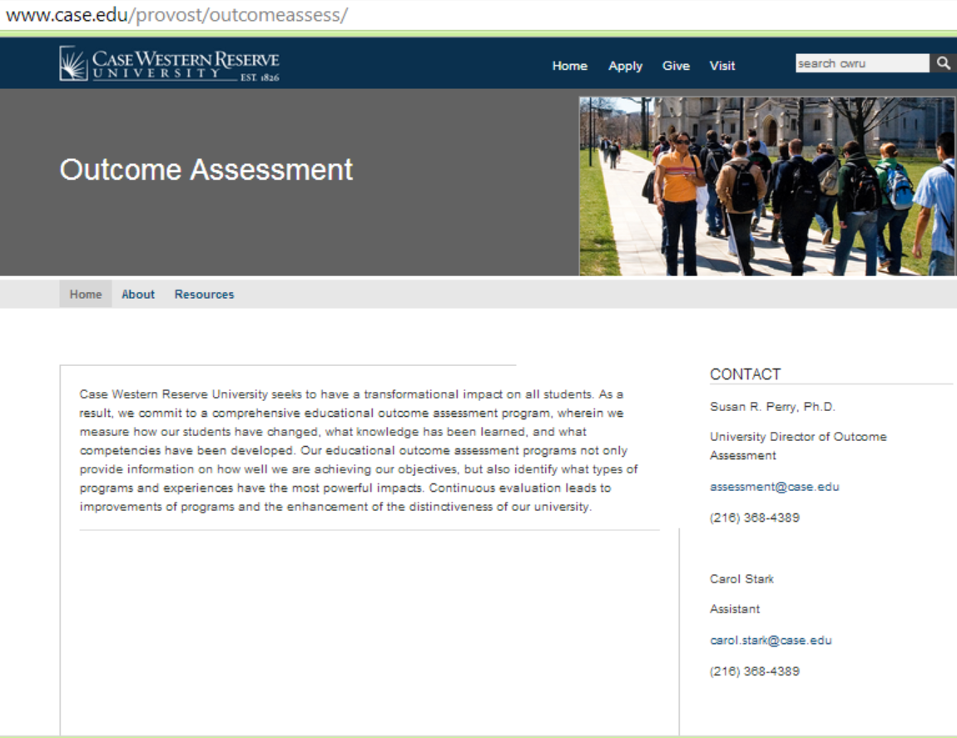
Website
Committees
Resources
Calendar

Slide 6
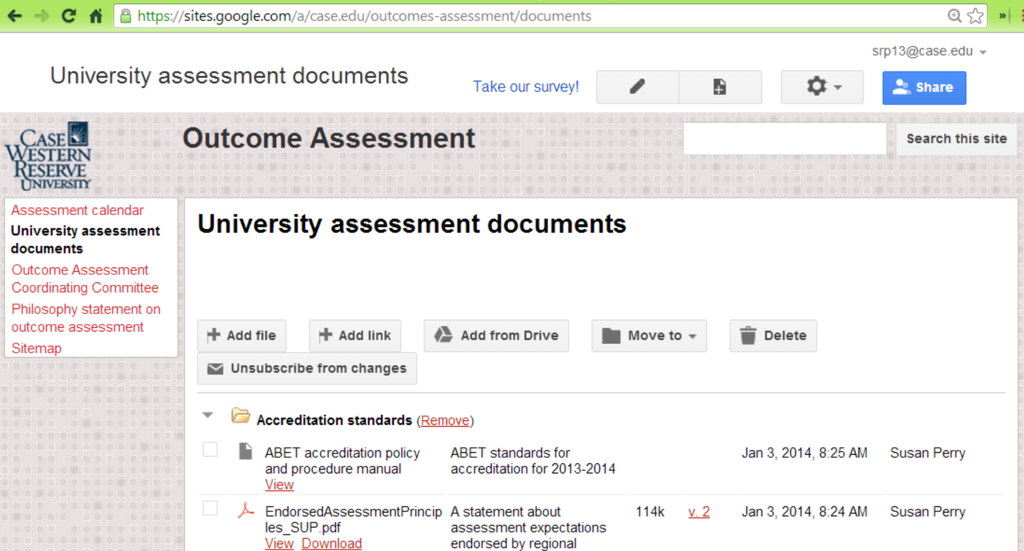
Google site
University documents
Shared committee documents
Presentations
Accreditation standards
Assessment plans

Slide 7
Other committees and groups
  Academic Affairs Council
  Academic Departments/Schools
  First Year Advisory Council
  Graduate Studies
  HLC Assurance Argument Committee
  International Affairs
  IR
Grant applications
  ITS
  KSL
  SAGES
  Student Affairs
  Survey Advisory Group

Slide 8
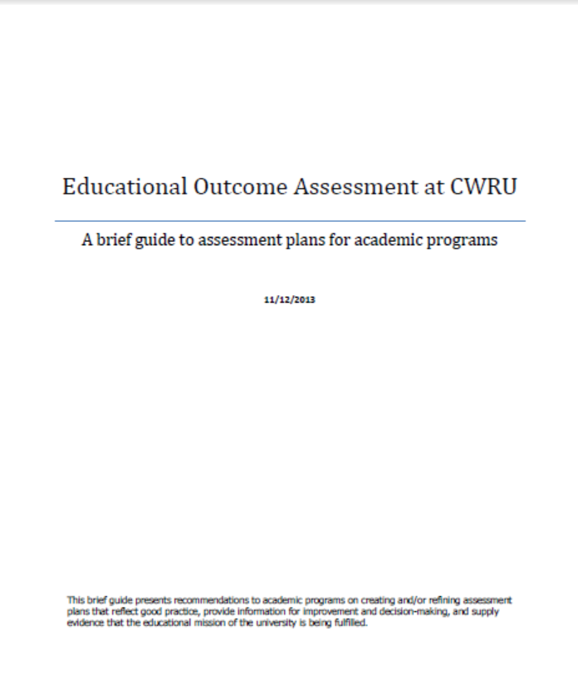
Professional development
UCITE sessions
  Developing learning outcomes
  Developing assessment plans
  Assessment – am I doing it right?
  Assessment and accreditation
Workshops and meetings
Guide:
Outcome Assessment > Resources > CWRU links and documents

Slide 9
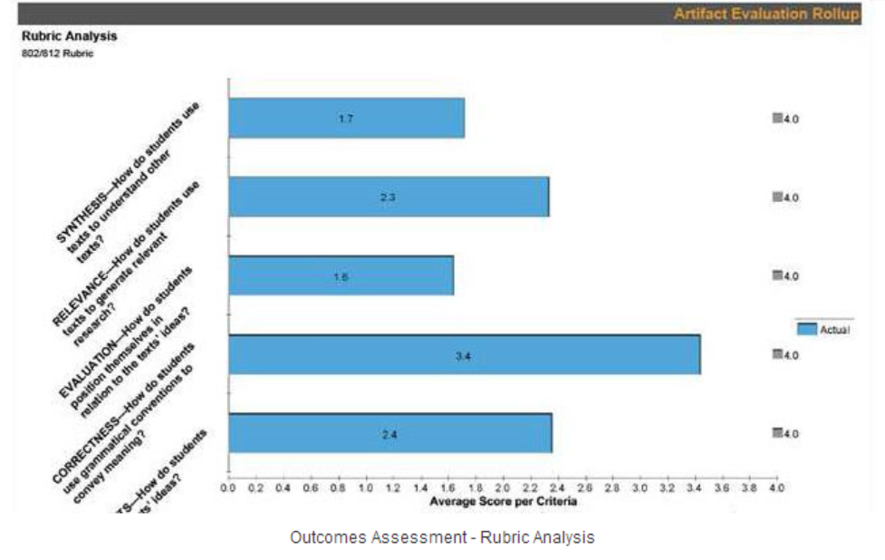
Tools
Blackboard Outcomes & Surveys
E-portfolio

Slide 10
Next steps
Communication & Collaboration
Professional Development
Tools & Best Practices
Culture

Slide 11

Susan Perry
assessment@case.edu
http://www.case.edu/provost/outcomeassess/

