Slide 1
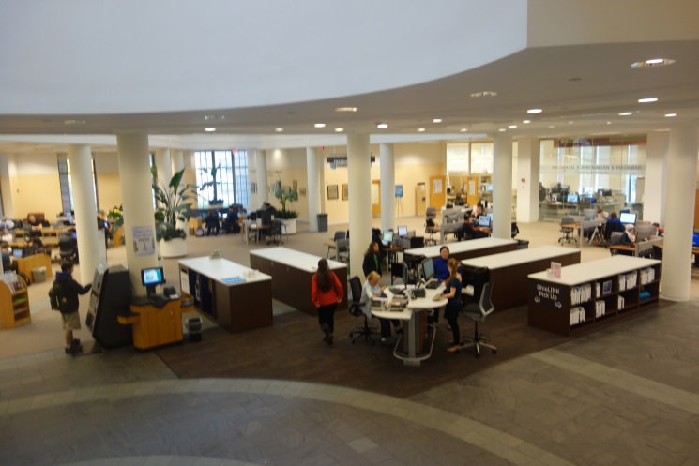
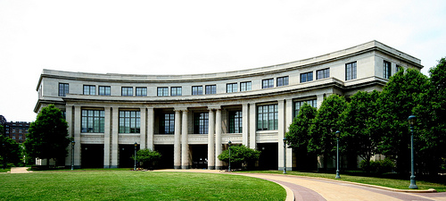
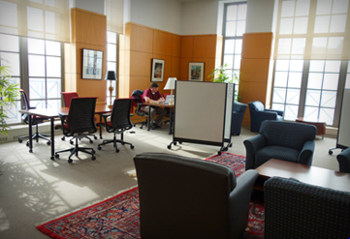
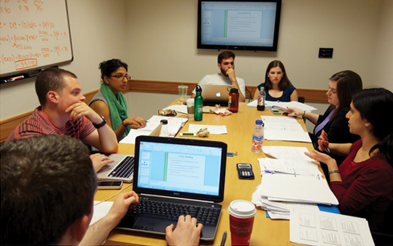
Faculty Senate Committee on University Libraries
March 2014
Faculty Senate Committee on University Libraries

Slide 2
FSCUL membership
Frank Merat, CSE, Chair
Mary Quinn Griffin, SON
Michael Landers, SODM
Cassandra Robertson, LAW
Damir Janigro, SOM
Amy Wilson, MSASS
Sarah Gridley, CAS
Kurt Koenigsberger, CAS
Silvia Prina, WSOM
Hongjin Su, undergraduate student representative
Lee Zickel, graduate student representative
Lynn Ulatowski, postdoc student representative
Kathleen Blazar, Interim Health Sciences Library, ex-officio
Ray Muzic, chair FSCICT, ex-officio
Andrew Plumb-Larrick, Law Library, ex-officio
Samantha Skutnik, MSASS Library, ex-officio
Arnold Hirshon, Associate Provost & University Librarian, ex-officio
Mark Henderson, Interim VP ITS, ex-officio

Slide 3
FSCUL activities
FSCUL has met 4 times (with two more meetings scheduled)
Responsibilities:
    The Committee on the University Libraries shall advise the University Librarian and the University administration on policies and procedures relating to the operations, facilities, and budget of the University Libraries. The Committee shall report regularly to the Senate, with recommendations as appropriate.

Slide 4
FSCUL: Digital Scholarship http://library.case.edu/ksl/freedmancenter/digitalscholarship/
Digital scholarship is the use of digital evidence, methods of inquiry, research, publication and preservation to achieve scholarly and research goals. Digital scholarship can encompass both scholarly communication using digital media and research on digital media.
“Digital Scholarship Call for Participation and Action 2-11-2014” available on KSL Website
CWRU Community and digital scholarship
  Faculty and students increasingly using digital scholarship and/or developing digital scholarship tools
  ITS, Freedman Center for Digital Scholarship, the Baker-Nord Center for Digital Humanities, etc. are increasingly providing support for digital scholarship
Call for Collaborative Participation and Action
  Inventory CWRU assets
  Organize working groups cutting across all CWRU communities
  Identify potential pilot projects and explore shared funding opportunities

Slide 5
FSCUL: Library Materials
CWRU’s ability to provide the Library Materials expected by our faculty & students and commensurate with our peer universities is being severely challenged by three factors:
The inflationary costs (~6%) of library materials
OhioLINK Central decreasing its support for electronic resources forcing CWRU to pick up costs of research essential resources at much higher costs, and
Reduced endowment funds to spend on materials due to a drop in the University’s spending rate for endowments.

Slide 6
FSCUL: Library Materials
CWRU has had to purchase reduced content at higher prices to maintain the current availability of materials. This will probably lead to significant cutting of electronic databases beginning as soon as summer 2014.
More financial details in “Library Materials Budget Overview: FY14 & FY15” (attached)
Requested Faculty Senate Finance Committee to review situation and recommend short and long-term financial solutions

Slide 7
Examples of Recent OhioLINK cost shifts

Slide 8
Examples of KSL Titles Under Consideration for FY15 Cancellation

Slide 9
Comparison with peer institutions
Note: CWRU figures include all libraries — including KSL, Health Sciences, Law and MSASS.
Notes:
The CWRU numbers are the total of the university libraries materials expenditures.
The schools shown are our peer institutions.

Slide 10
Examples of requested materials unable to purchase

Slide 11
Sense of the Faculty
(Approved by FSCUL 13 March 2014)
The library is a critical and basic operation of the University, and the library materials budget shapes the essence and core of the library. The Faculty Senate Committee on University Libraries wishes to transmit its serious concern to (the Faculty Senate and) the President and Provost that the continued lack of sufficient funding for library materials has resulted not only in a funding level that is significantly below that of our peer institutions, but has now reached a point at which mission-critical research materials can no longer be afforded and our ability to conduct research will be irreparably threatened.

Slide 12
Sense of the Faculty
(Approved by FSCUL 13 March 2014) (continued)
The new CWRU strategic plan, Think Beyond the Possible: 2013-2018, states as a goal that CWRU will “…provide library information content, services and resources commensurate with those of our university peers…”
To achieve this essential goal, the Faculty Senate Committee on University Libraries urges that the President and the Provost give serious and immediate attention to identifying and implementing solutions, beginning with FY2015, that will enable the funding of library materials not only to meet the basic information needs of faculty and students, but also to begin a multi-year process to grow the funding so that it is fully commensurate with that of our peer institutions.

