Slide 1

think:
international
WE BRIDGE CWRU AND THE WORLD
Presentation to the Faculty Senate
March 31, 2014
CENTER FOR
INTERNATIONAL AFFAIRS
Center for International Affairs

Slide 2


Vision Statement
    The Center for International Affairs provides leadership, expertise, and support to the Case Western Reserve University community, cultivating a dynamic international presence and inspiring a culture of global understanding and responsibility.
    CENTER FOR INTERNATIONAL AFFAIRS:
    Office of International Affairs
    Office of International Student Services
    Office of Education Abroad
Board of Trustees
September 15-16, 2011

Slide 3
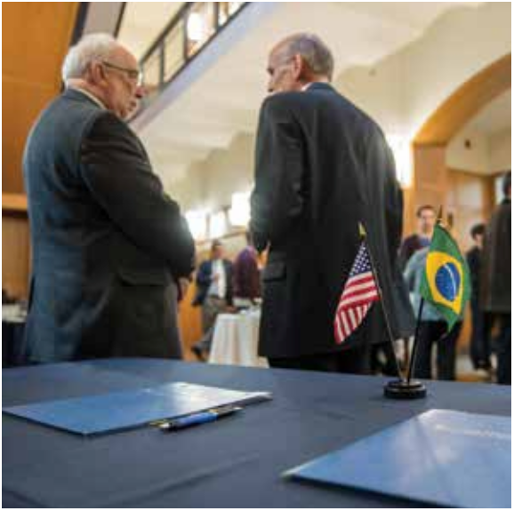

2013 Highlights
Memorandum of Understanding signed between CWRU and CAPES in Brazil, creating STEM opportunities in SOM, SODM, CSE, FPBSON, and CAS
Launched the first CWRU-developed, semester-long study abroad program at the Royal Academy of Dramatic Arts (RADA) in London
WRU faculty and students pursue research collaborations and other academic projects in brazil.

Slide 4

2013 Highlights
Inaugurated Global Talk Series with lunch conversations on topics such as study abroad tips for faculty advisors, cross-cultural communication, and developing international agreements
Awarded more than $37,000 to fund Faculty Seed Grants for Internationalization in areas such as:
Researching Women’s Studies in the Arab Word: An Interdisciplinary Approach (CAS)
Water Quality, Engineering, Bioethics and Health in Costa Rica (CSE & SOM)
Curriculum Development in Romania: Adoption Mental Health Certificate Program (MSASS)

Slide 5
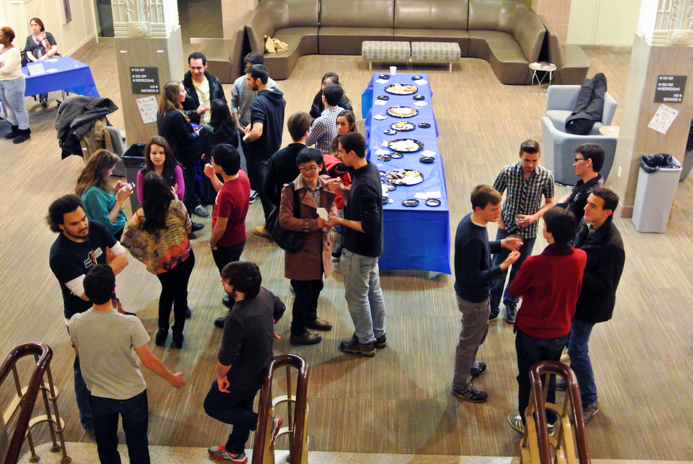

2013 Highlights
In conjunction with Career Services, organized Mandarin-Speaking Professionals and Graduate Students Networking Workshop and Employer Reception
Planned and executed expanded International Education Week

Slide 6

            Plan for Internationalization
    “Include and support international experience for undergraduates as a core component of the University’s internationalization efforts and a necessary part of instilling global competence in its students”
Board of Trustees
September 15-16, 2011

Slide 7
          Plan for Internationalization
“Enroll international undergraduate students who will have a successful student experience, engage fully in student life and graduate at a rate equal to non-international students”
Board of Trustees
September 15-16, 2011
11.5%
6.8%
8.7%
8.4%
6.9%
2.5%

Slide 8
Board of Trustees
September 15-16, 2011
            Plan for Internationalization
“Build a structure for the Center for International Affairs to support internationalization”
    Created position to assist international scholars and faculty members, as well as students as they acclimate to CWRU
    Enhanced coordination for faculty participation in the Fulbright Program
    Established International Affairs Advisory Council, International Affairs Visiting Committee, and Education Abroad Advisory Committee

Slide 9
Board of Trustees
September 15-16, 2011
          Plan for Internationalization
“Establish university-wide international risk management policies and practices”
    International risk management policy has been written and reviewed
    Policy will be presented to President’s Cabinet and Council

Slide 10
              Plan for Internationalization
“Develop the technology to support internationalization”
    Implemented state-of-the-art study abroad technology
    Creating upgraded systems for government document processing – eventually going to paperless
    Creating database for international agreement approval process
    Working with IT to include international concerns in creating a comprehensive database and reporting tool for faculty (Faculty Lifecycle Project)
Board of Trustees
September 15-16, 2011

Slide 11
            Plan for Internationalization
“Articulate a set of specific institutional strategic initiatives to solidify the university’s commitment to, and provide momentum for, internationalization of the university. Recommendations for specific strategic initiatives should…[i]dentify a portfolio of geographic sites, university partners, and types of engagement (including the rationale for such recommendations)”
Identified geographic sites are: Association of Southeast Asian Nations (ASEAN*), Brazil, India, Turkey, Uganda
Board of Trustees
September 15-16, 2011
      * Brunei, Cambodia, Indonesia, Laos, Malaysia, Myanmar, Philippines, Singapore, Thailand, Vietnam

Slide 12
Board of Trustees
September 15-16, 2011
              Plan for Internationalization
“Request faculty to consider undergraduate curriculum initiatives”
    In other sections of the Plan [for internationalization], the IPC has made specific recommendations to internationalize undergraduate education – including, among other things, enhanced study abroad opportunities, increased numbers of international students and improved international student retention and integration strategies. The IPC recognizes that, since the undergraduate curriculum is at the core of the university’s teaching mission, curriculum is an important part of a plan to internationalize undergraduate education. The undergraduate curriculum quite appropriately stems from discipline and program needs and expectations, and is based on faculty expertise and interests. Although elements of curriculum (and related educational activity) may be impacted by the recommendation in this Plan, the IPC has not conducted a curriculum review and is not making any specific recommendations. Rather, the IPC asks the faculty to review this Plan and, in light of its strategy to internationalization the university, determine whether and how the curriculum might change to support that strategy.

Slide 13

bridging opportunities
Ideas and Discussions
CENTER FOR
INTERNATIONAL AFFAIRS
Tomlinson Hall, 143
10900 Euclid Avenue
Cleveland, Ohio 44106-7031
216-368-2517 www.case.edu/international

