Slide 1
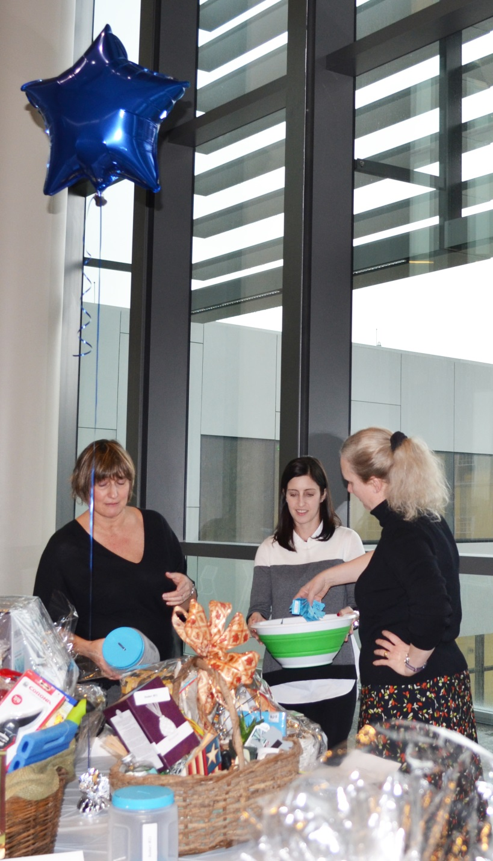
14th annual basket raffle sponsored by:
Staff Advisory Council
COMMUNITY SERVICE committee
2014 proceeds donated to:
SEEDS OF LITERACY & the AMERICAN HEART ASSOCIATION
(in honor of robin kramer)

Slide 2
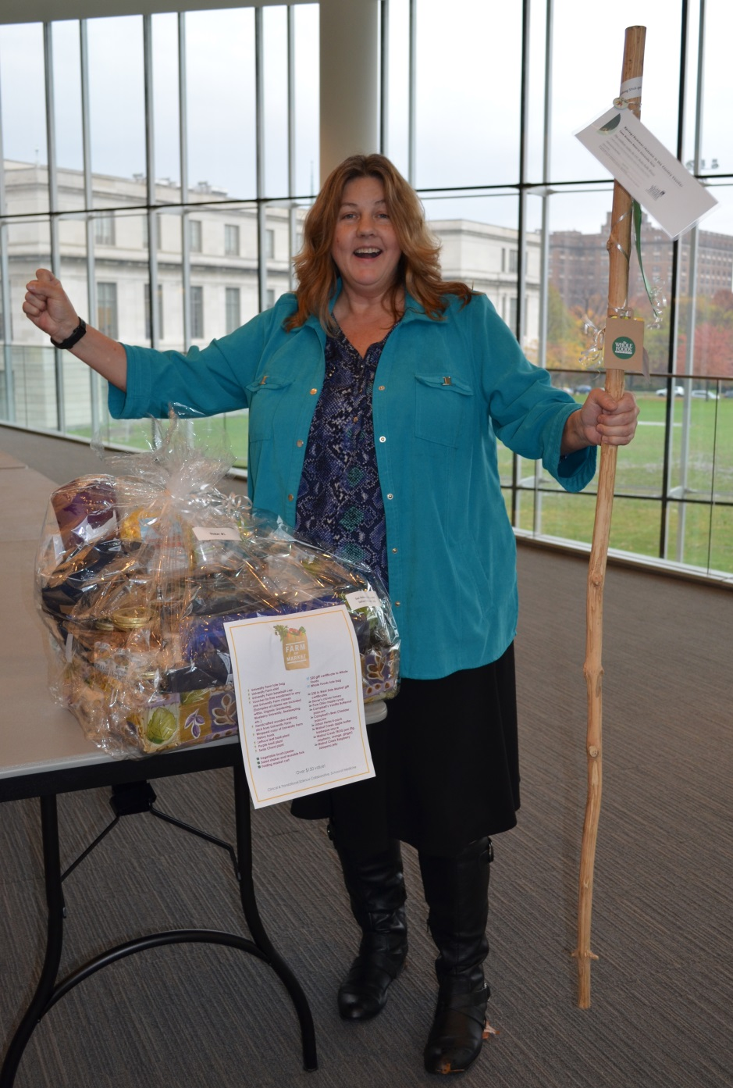
Winner:
Dawn Brown (Biochemistry)
Basket donated by:
Clinical & Translational
Science Collaborative

Slide 3
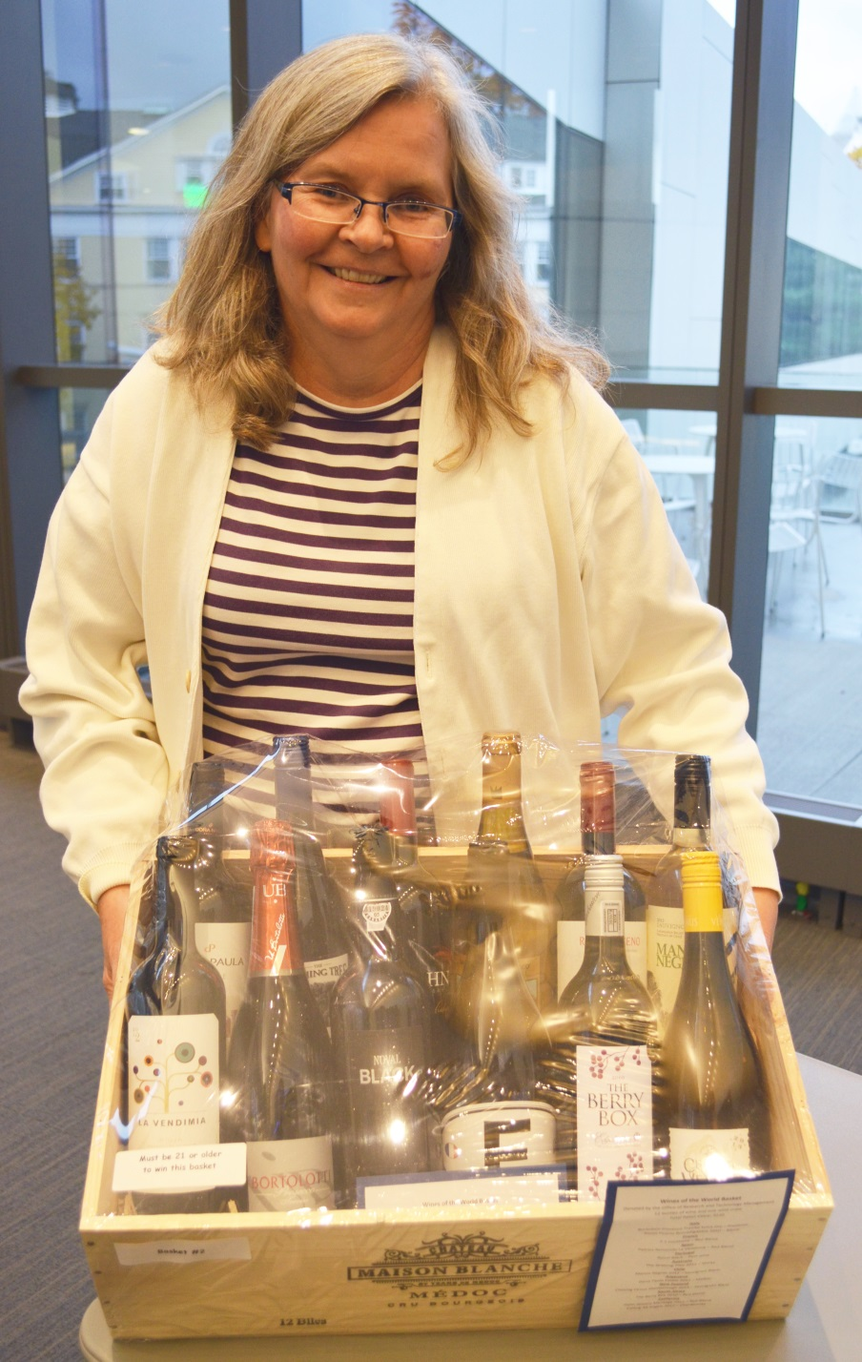
Winner:
Kathryn Howard
(Chemistry)
Basket donated by:
Office of Research & Technology Mgmt.

Slide 4
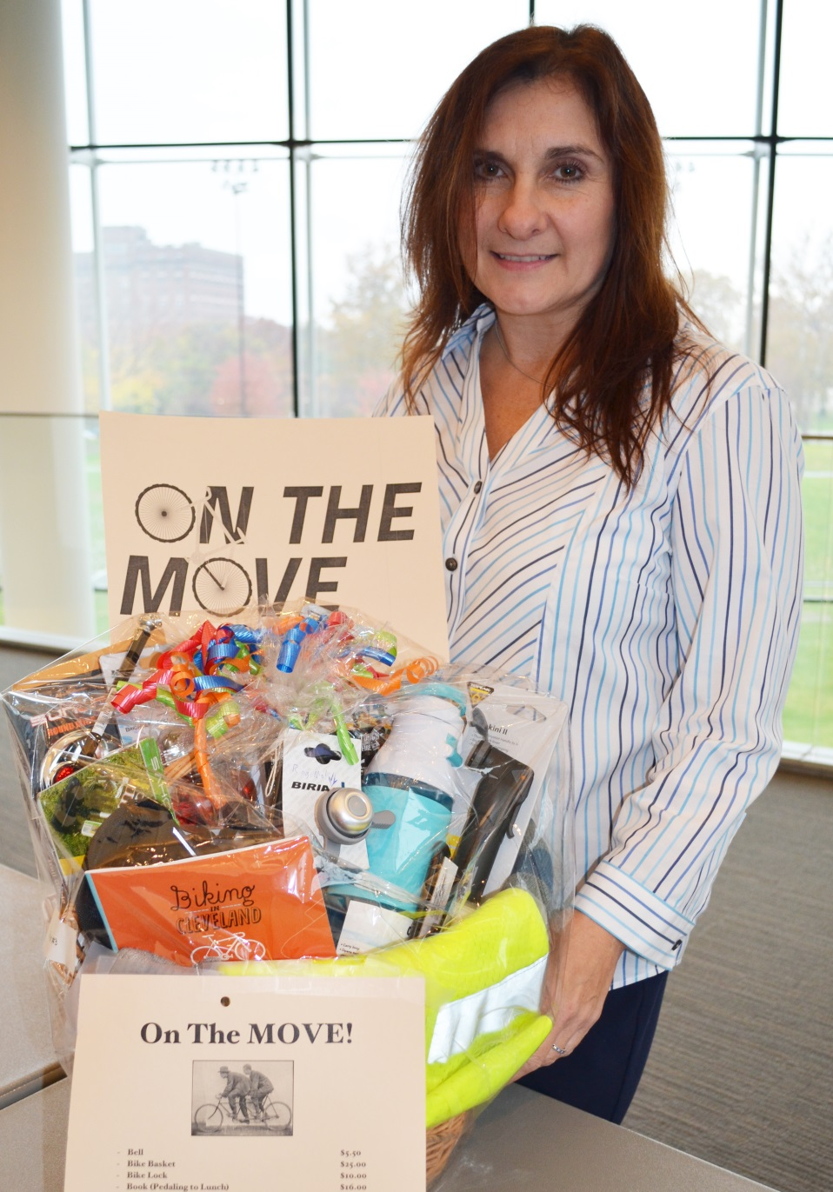
Winner:
Renee O'Connor
(Office of General council)
Basket donated by:
Mandel School of Social Sciences

Slide 5
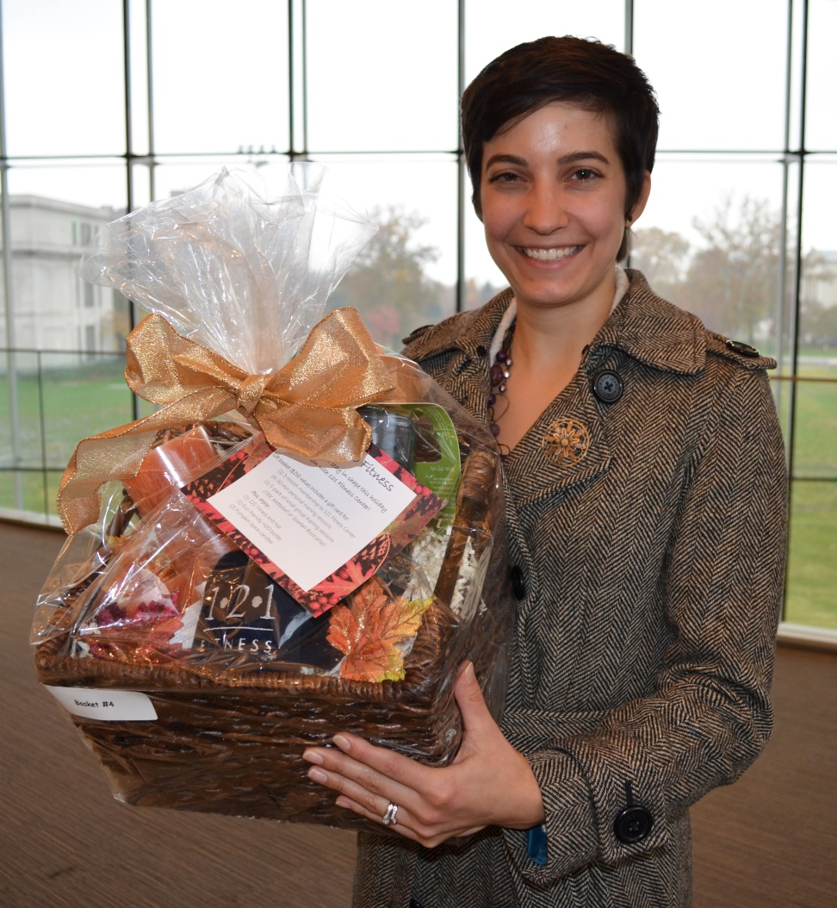
Winner:
Katherine Gullett
(The Fowler Center for Sustainable Value)
Basket donated by:
121 Fitness Center

Slide 6
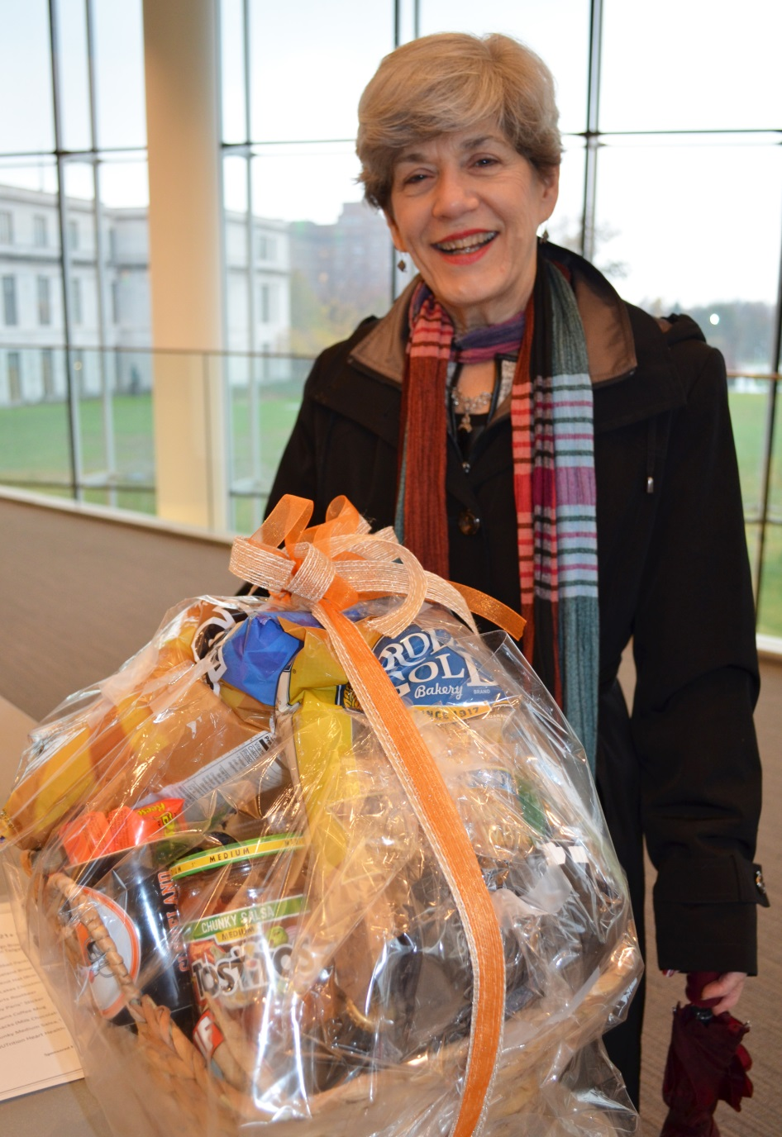
Winner:
Lois Langell
(Office of Deputy Provost)
Basket donated by:
Student Activities & Leadership

Slide 7
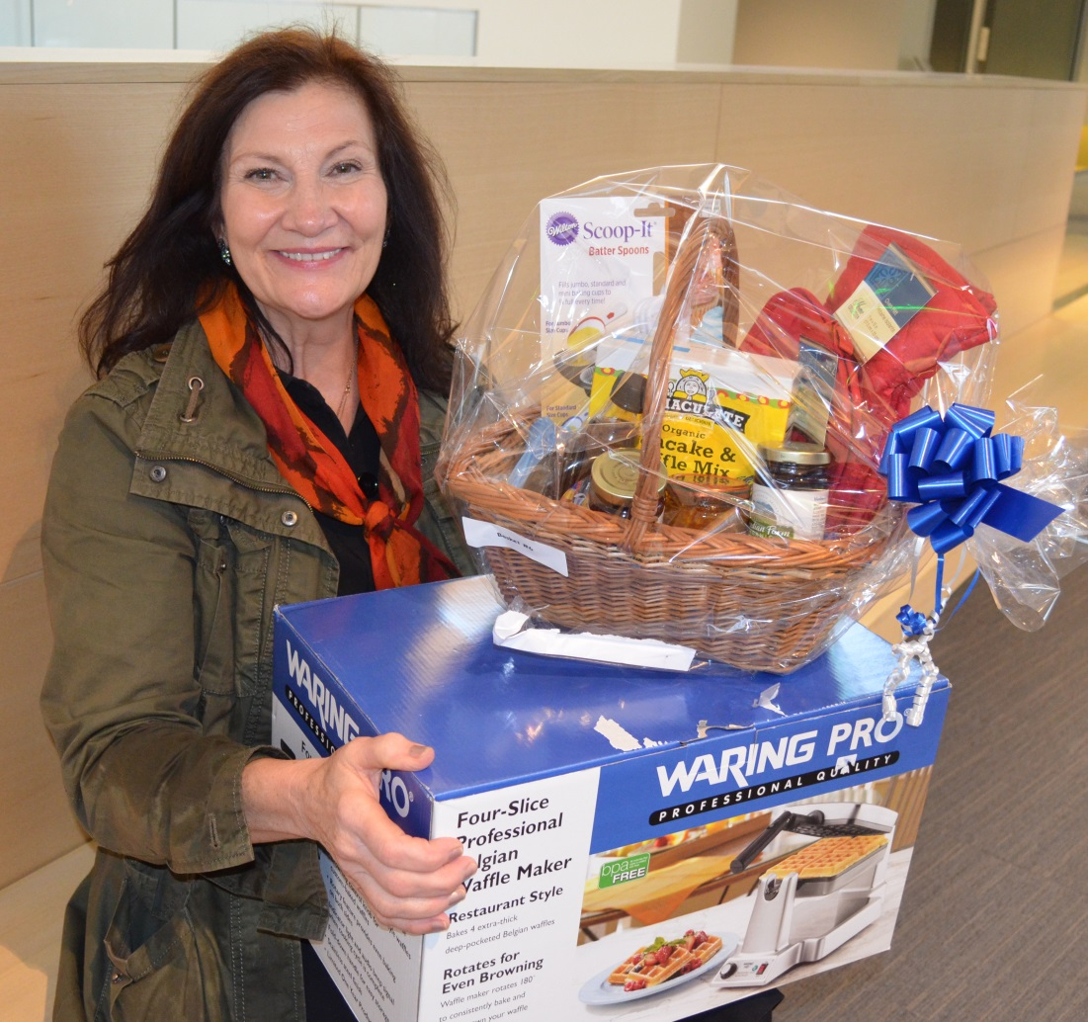
Winner:
Cynthia McConnaughy
(Craniofacial Imaging Center – SODM)
Basket donated by: frances payne bolton school of nursing

Slide 8
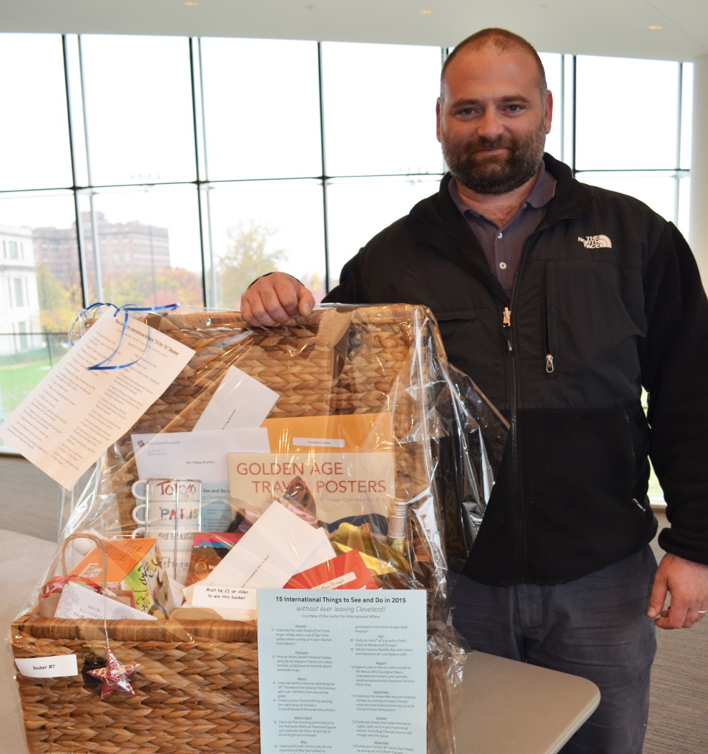
Winner:
Chris Bond (FARM Food Program)
Basket donated by:
Center for International Affairs

Slide 9
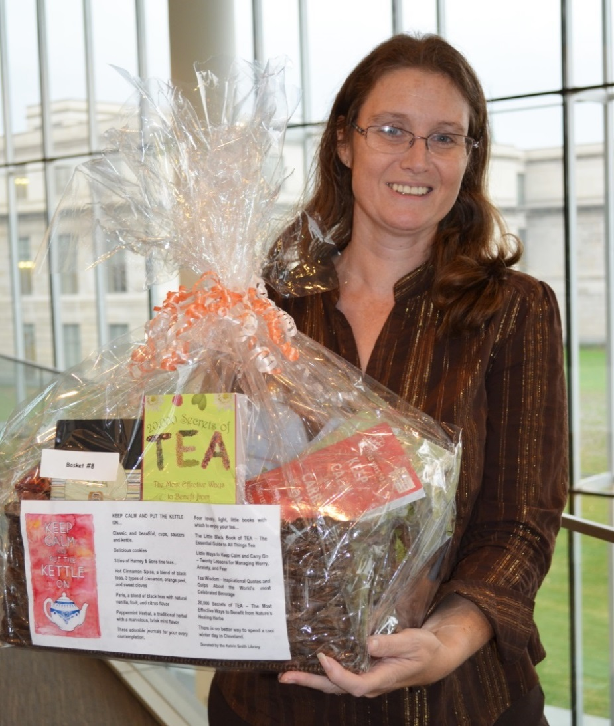
Winner:
Karyn Newton (Office of Inclusion, diversity & Equal)
Basket donated by:
Kelvin Smith Library

Slide 10
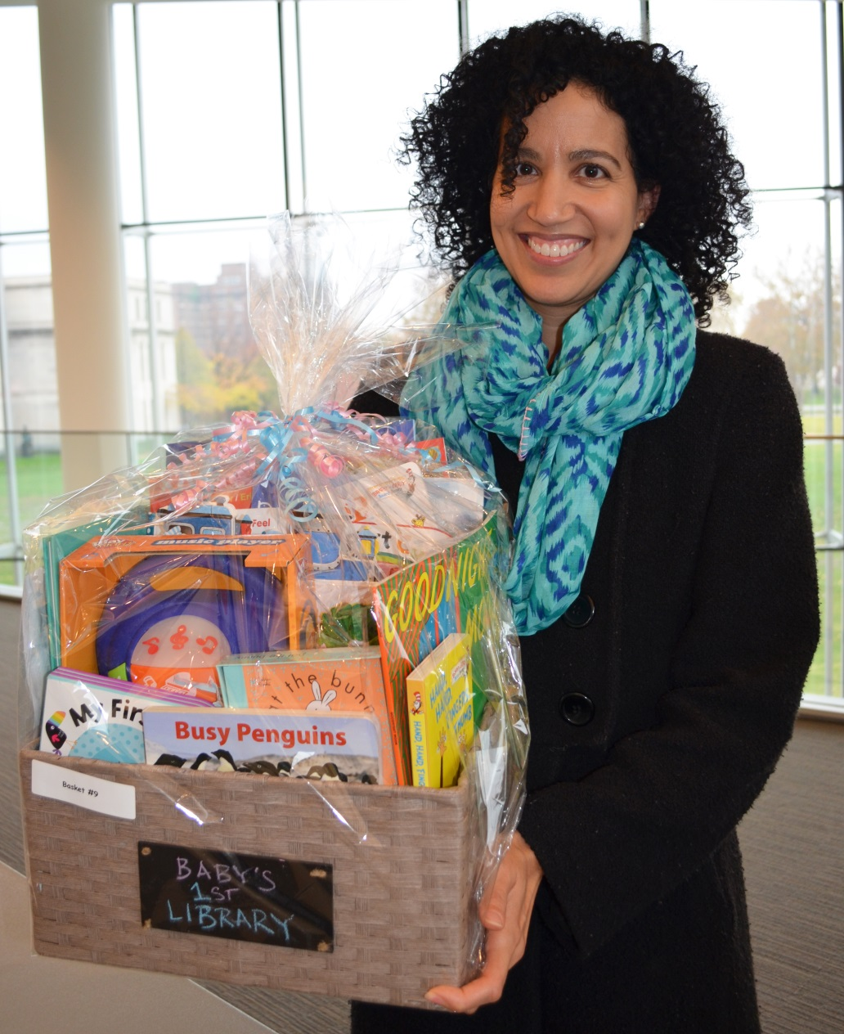
Winner:
Carmen Hendricks
(Undergraduate Admissions)
Basket donated by:
Kelvin Smith Library

Slide 11
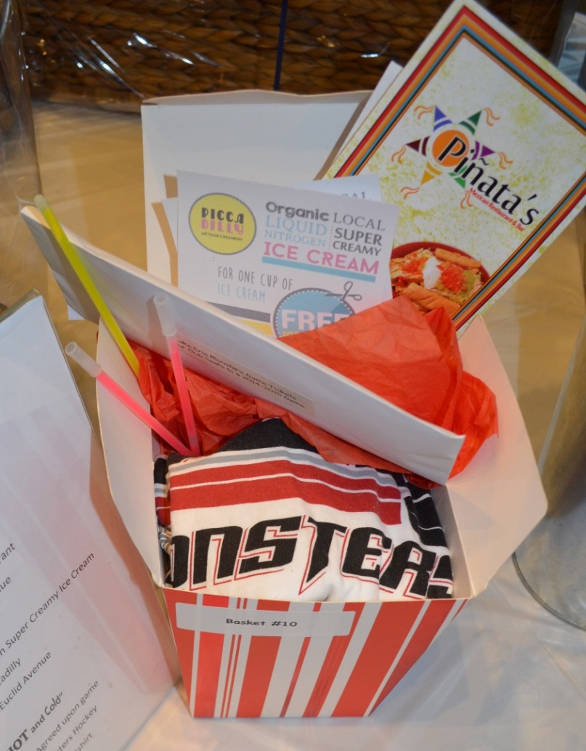
Winner:
Kristi Ammons (UH dermatology)
Basket donated by:
Career Center - Blackstone LaunchPad
)

Slide 12
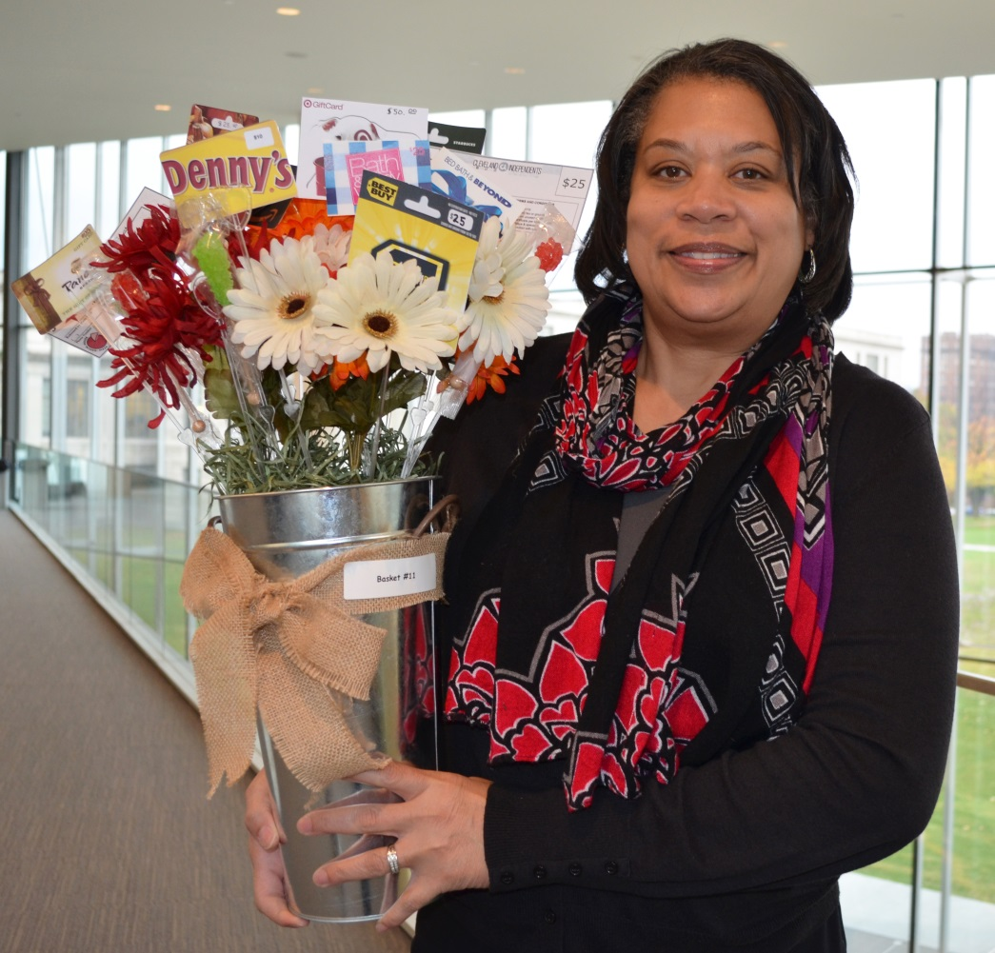
Winner:
Michelle Saafir (Campus Services Administration)
Basket donated by:
Information technology Services

Slide 13
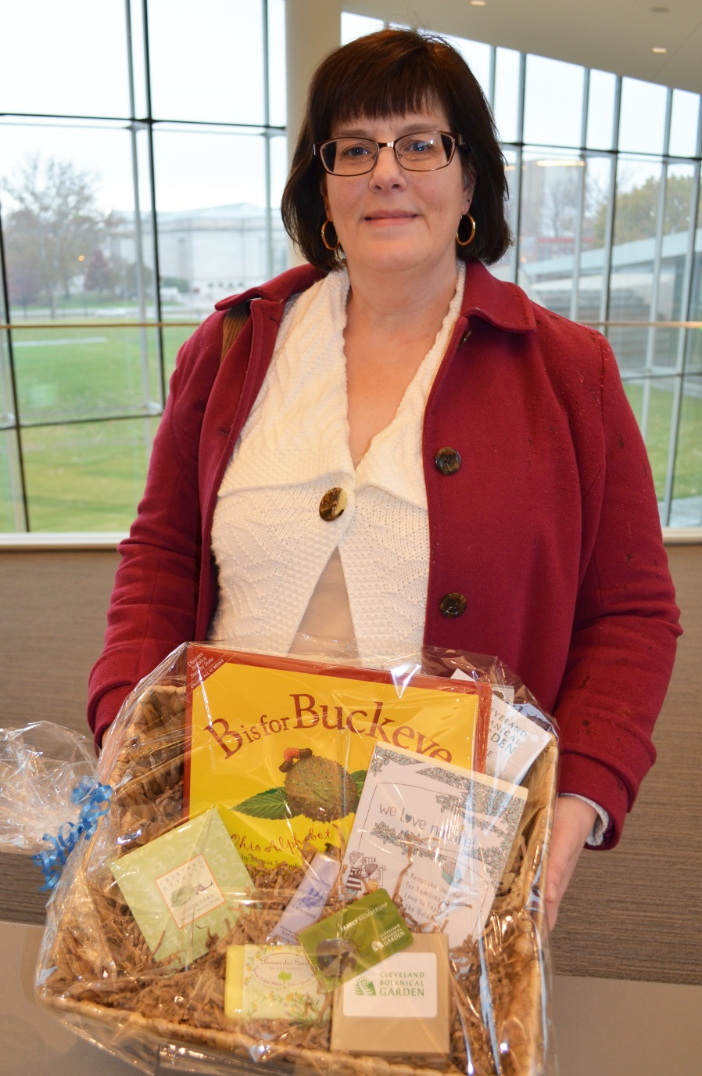
Winner:
Lisa Peters
(Law Library)
Basket donated by:
Schubert Center for Child Studies

Slide 14
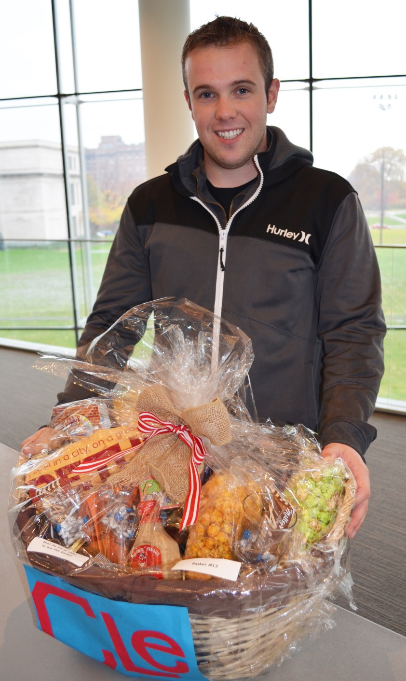
Winner:
Jeff Senuta
(Student Affairs Coordinator - CSE)
Basket donated by:
Office of the University Registrar

Slide 15
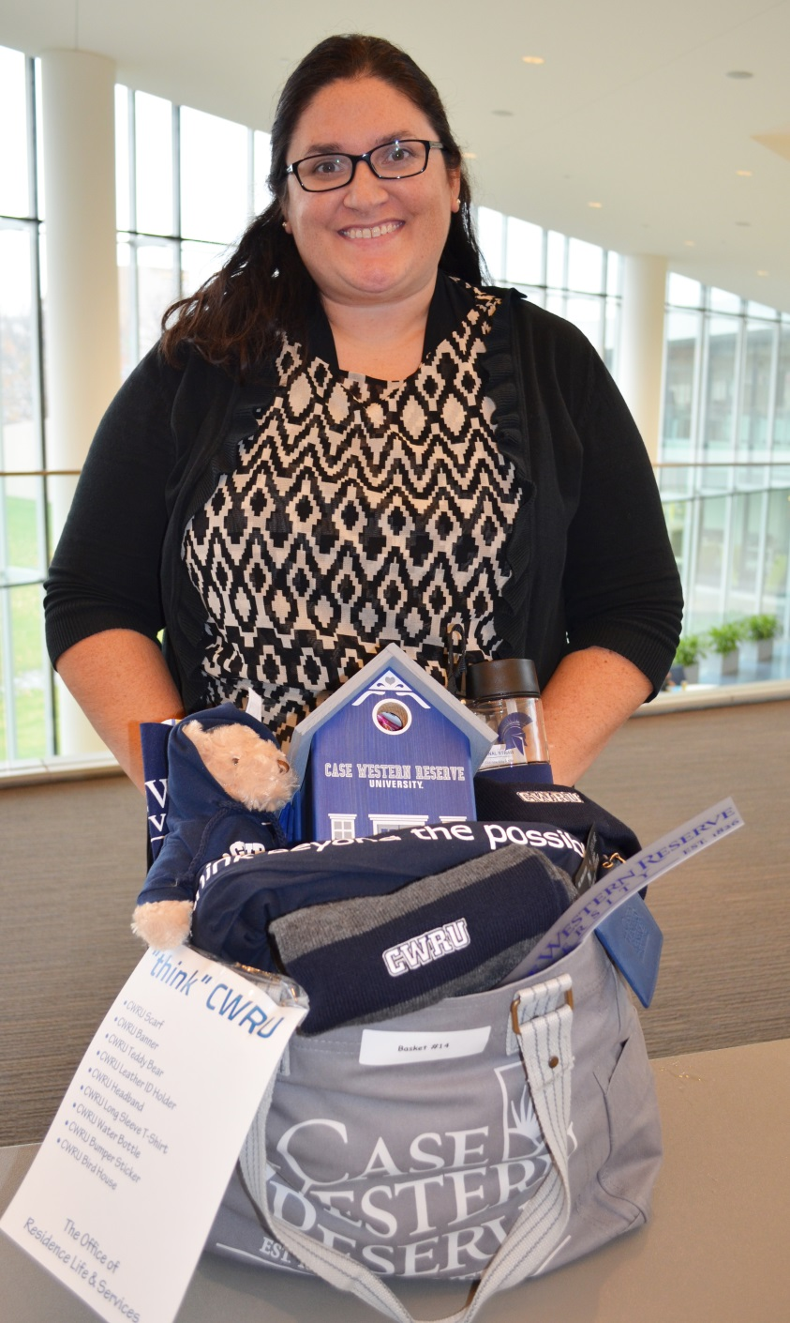
Winner:
Jessica Calvin
(controller’s office)
Basket donated by:
Residence Life and Services

Slide 16
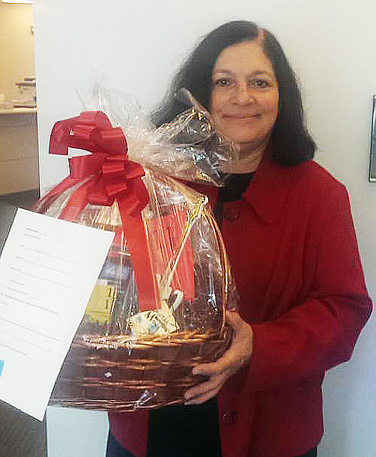
Winner:
Amy Bieda
(School of Nursing)
Basket donated by:
Human Resources

Slide 17
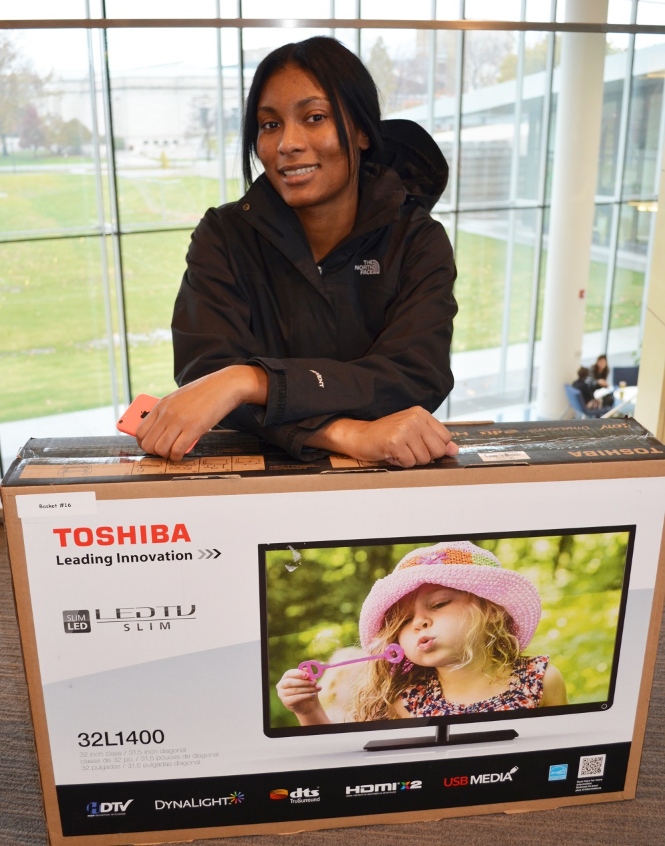
Winner:
Tiara Jefferson
(AEGD – SODM)
Basket donated by:
Police & Security Services

Slide 18
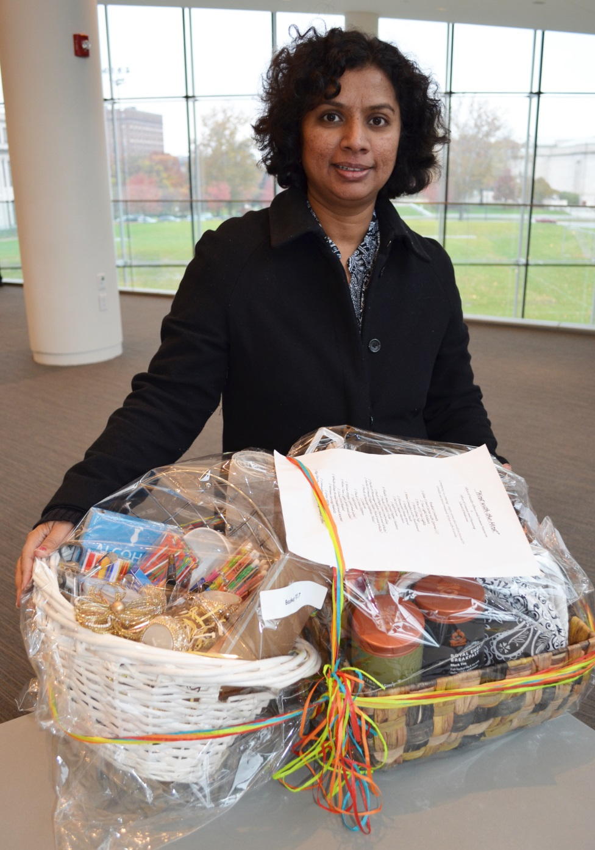
Winner:
Rekha Srinivasan
(Chemistry)
Basket donated by:
SOM Office of Faculty Affairs & Human Resources and
Office of Finance & Planning

Slide 19
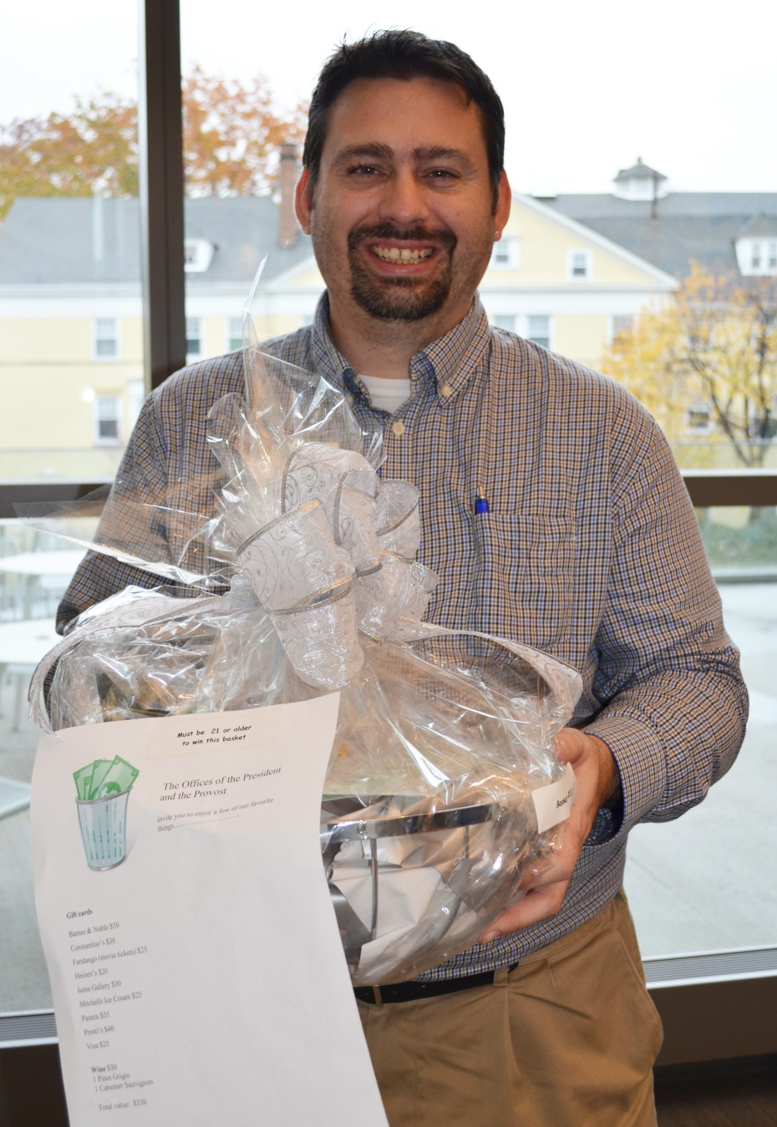
Winner:
Brian Gray
(Library Services)
Basket donated by:
Offices of the President & Provost

Slide 20
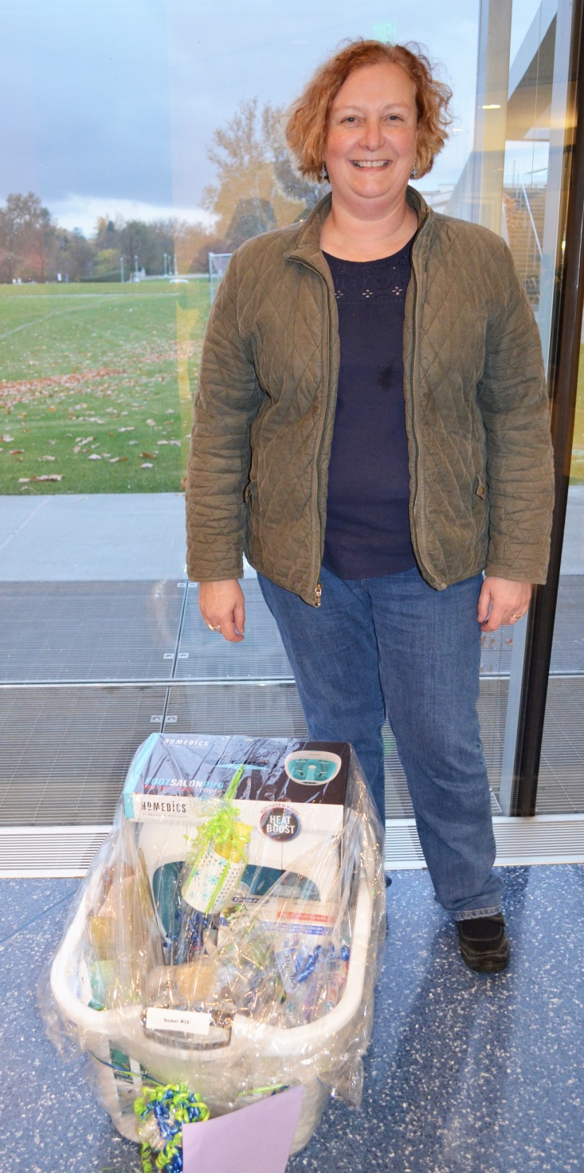
Winner:
Colleen Croniger
(Nutrition)
Basket donated by:
School of Dental Medicine
(smile team)

Slide 21
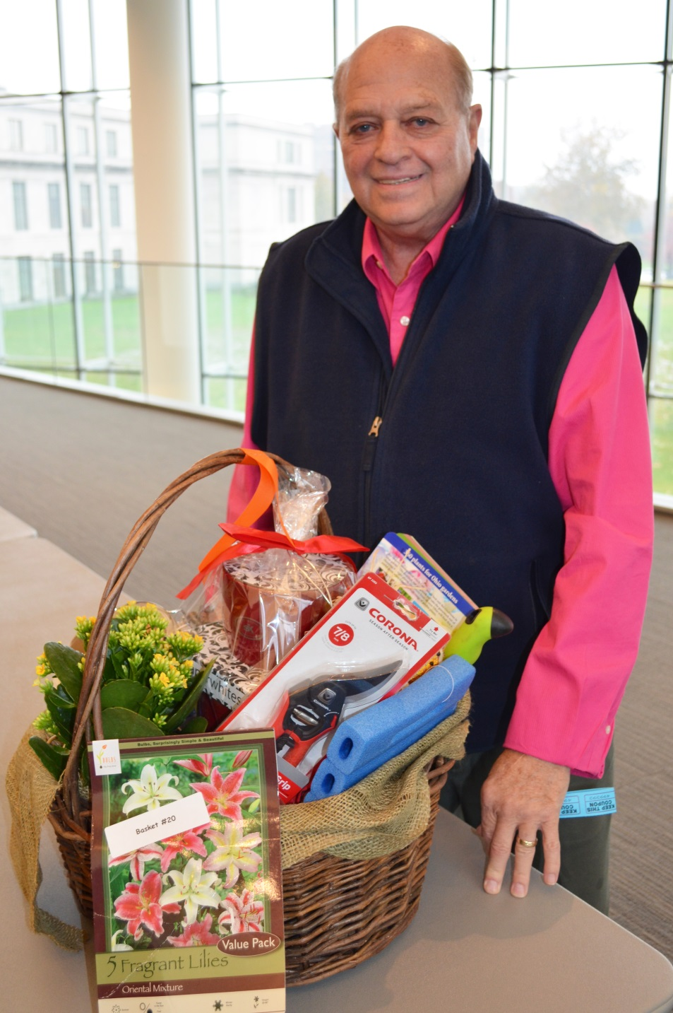
Winner:
Tom Bondra
(Facilities Services)
Basket donated by:
Grounds Maintenance

Slide 22
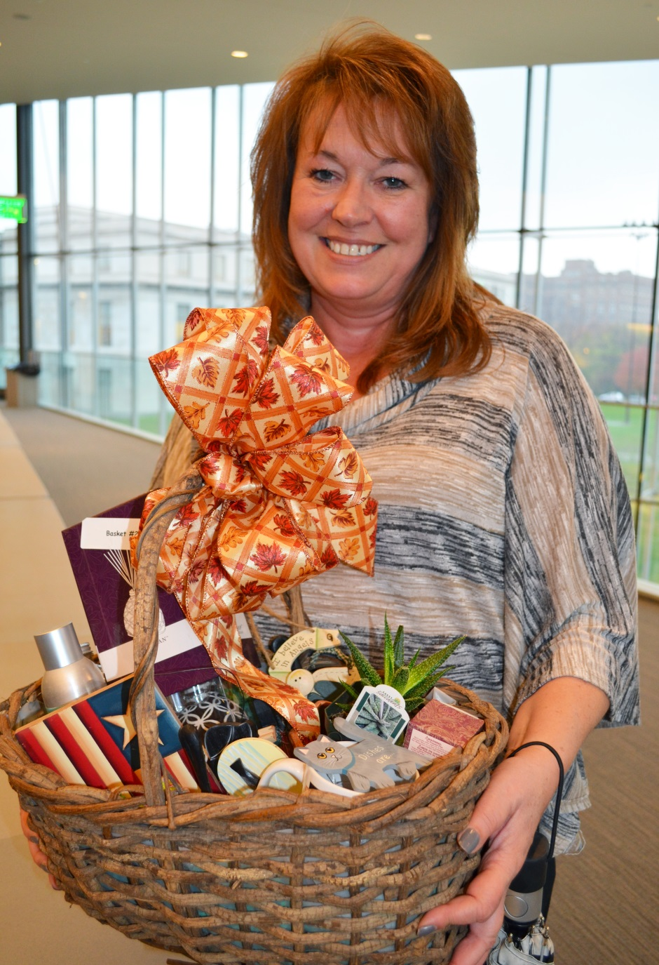
Winner:
Dee Kirks
(Enrollment Management )
Basket donated by:
Grounds Maintenance

Slide 23
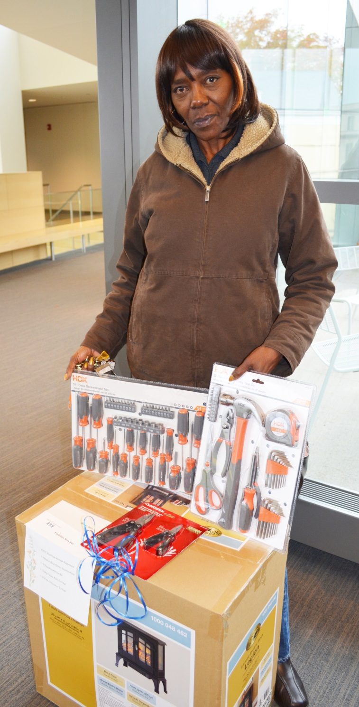
Winner:
Gladys McDowell
(Endodontics - SODM)
Basket donated by:
Plant Services

Slide 24
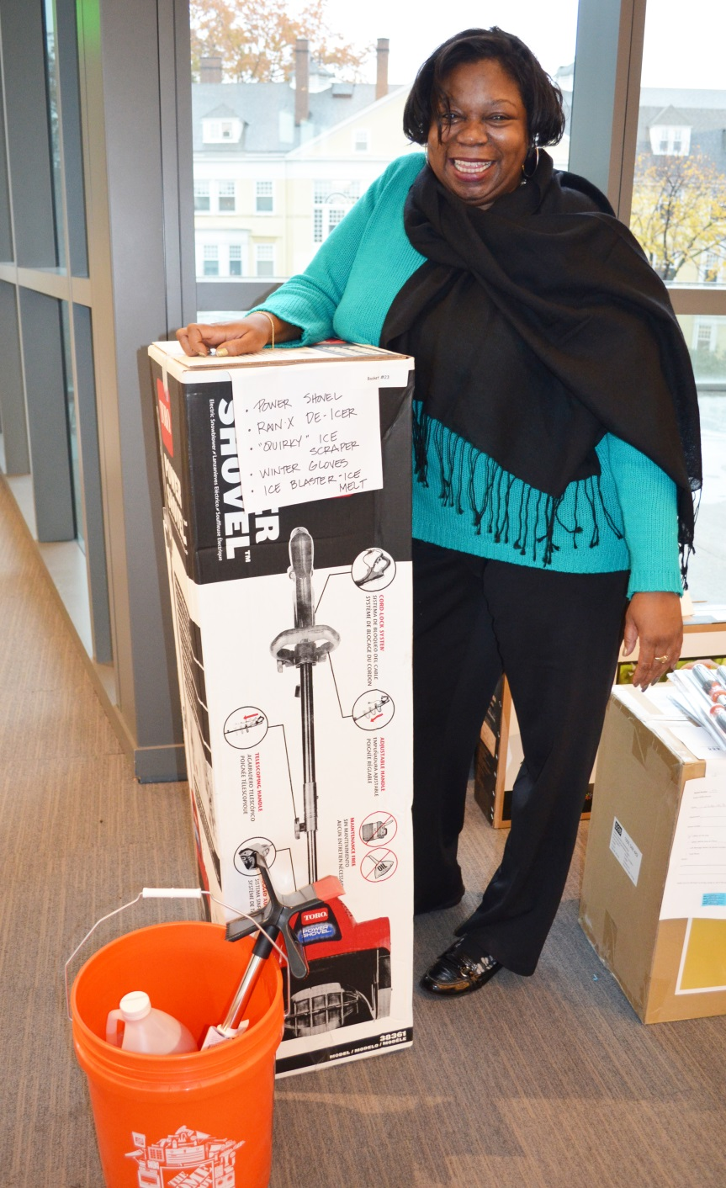
Winner:
Tonya Phillips
(Admissions)
Basket donated by:
Planning Design & Construction

Slide 25
SAC COMMUNITY SERVICE COMMITTEE
BASKET RAFFLE HISTORY
# | Year | Charity | Amount
1st | 2001 | PROVIDENCE HOUSE | $ 1,600.00
2nd | 2002 | JOSEPH LANDIS SCHOOL/ MARY BETHUNE ELEMENTARY SCHOOL | $ 5,000.00
3rd | 2003 | SHOES AND CLOTHES FOR KIDS | $ 6,000.00
4th | 2004 | SHOES AND CLOTHES FOR KIDS | $ 4,500.00
5th | 2005 | SALVATION ARMY, HURRICANE KATRINA | $ 6,000.00
6th | 2006 | CLEVELAND HUNGER NETWORK | $ 5,500.00
7th | 2007 | RESTORE CLEVELAND HOPE (Cozad Bates House) | $ 4,000.00
8th | 2008 | TRANSITIONAL HOUSING | $ 4,000.00
9th | 2009 | BELLFLOWER CENTER FOR THE PREVENTION OF CHILD ABUSE | $ 3,000.00
9th | 2009 | METRO HEALTH FRIENDS OF MOTHERS & INFANTS | $ 1,000.00
10th | 2010 | SUICIDE PREVENTION EDUCATION ALLIANCE | $ 4,500.00
11th | 2011 | HOSPICE OF THE WESTERN RESERVE | $ 4,200.00
12th | 2012 | MURTIS TAYLOR HUMAN SERVICES SYSTEM | $ 4,000.00
12th | 2012 | YOUTH CHALLENGE | $ 1,500.00
13th | 2013 | FAMILY PROMISE | $ 1,900.00
13th | 2013 | PROJECT NIGHT NIGHT | $ 3,600.00
14th | 2014 | AMERICAN HEART ASSOCIATION | $ 2,000.00
14th | 2014 | SEEDS OF LITERACY | $ 4,000.00
 |  | Total | $ 66,300.00

Slide 26
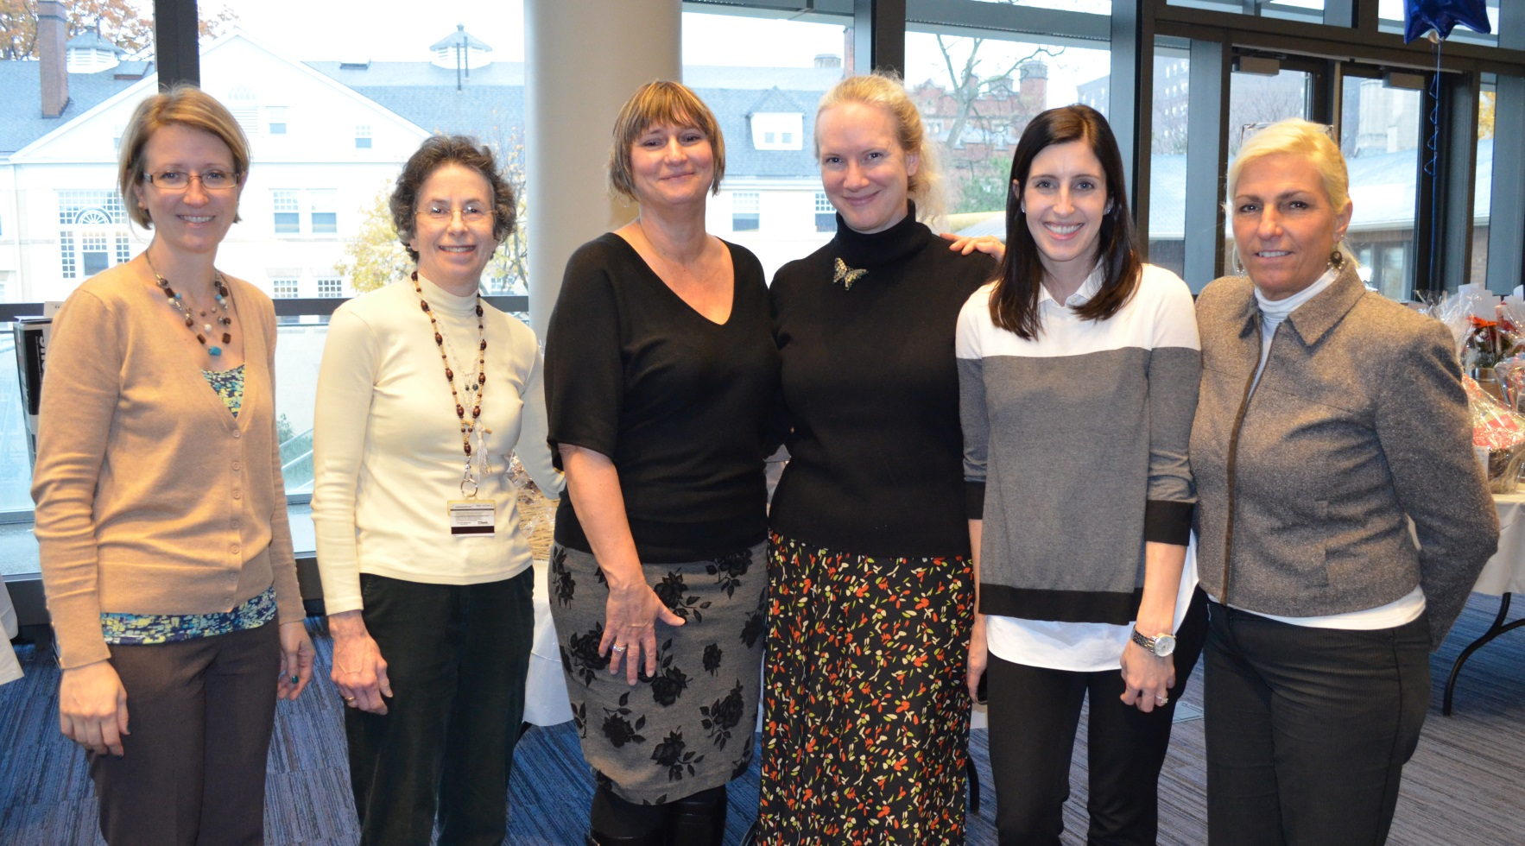
SAC COMMUNITY SERVICE members with representatives from
SEEDS OF LITERACY & the AMERICAN HEART ASSOCIATION
Thank you! See you next year!

