Slide 1
MATH 408
Digital Signatures and Digital Certificates
Class Notes
Prof. David Singer

Slide 2
Cryptographic Services
Privacy (encryption) – You can’t see it
Integrity (signing) – You can’t change it

Slide 3
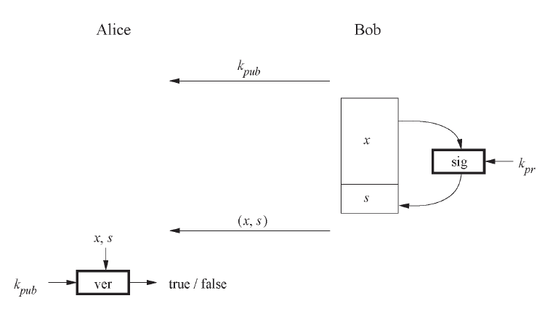
Digital Signatures
The basic scheme is shown here:

Slide 4
Digital Signatures
1.Bob signs using his private key.
2.Alice can verify the signature using Bob’s public key.
3. Anyone else can also verify Bob’s signature.
4. Since only Bob has the private key, only he could have signed. (Nonrepudiation)

Slide 5
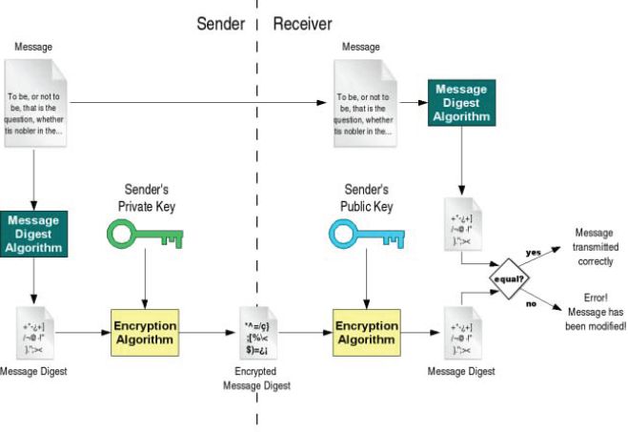
Digital Signatures
A more complete description:

Slide 6
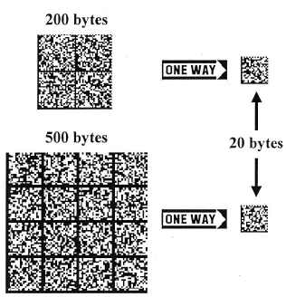
Secure Hash Function
A hash function is a compressed version of the message, using a one-way function.
The hash size is independent of the size of the message.

Slide 7
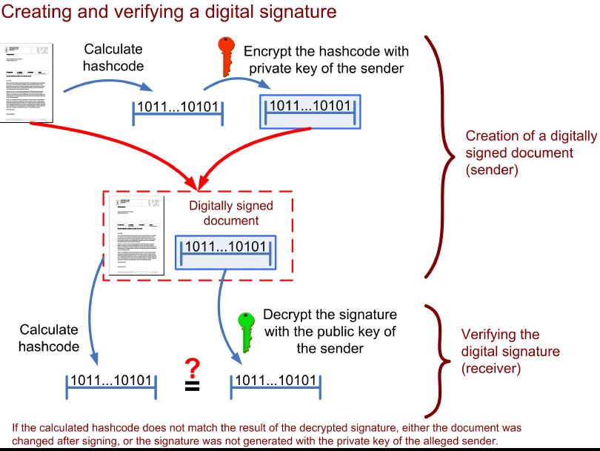

Slide 8
Why a “secure” hash?
Efficiency: only a small amount of data has to be encrypted.
Integrity: any change in the document will cause major change in the hash and invalidate the signature.
Nonrepudiation: Bob cannot later deny signing.

Slide 9
What is a “secure” hash?
A one-way function has the property: Given x, it is ‘hard’ to find another x’ with f(x)=f(x’).
This property, called (weak)collision-resistance, is vital for security against forgery.
In fact, we should need a stronger condition: it is hard to find x and x’ with f(x)=f(x’).

Slide 10
ECDSA

Slide 11
Signature

Slide 12
Signature

Slide 13
Signature

Slide 14
How big is the prime?

Slide 15
Certificate Authority (CA)
CA verifies identity and credentials of user (in person or by some other non-crypto method)
Issues certificate of public key.
Transmits key pair to user securely.
User can publish certificate.

Slide 16
Certificate Authority (CA)
Certificate has expiration date.
CA needs to be able to revoke certificate before expiration.
CA needs to backup keys and have procedure for recovery of lost keys.
Note: Certificates are included in browsers (IE, Firefox, etc.).

Slide 17
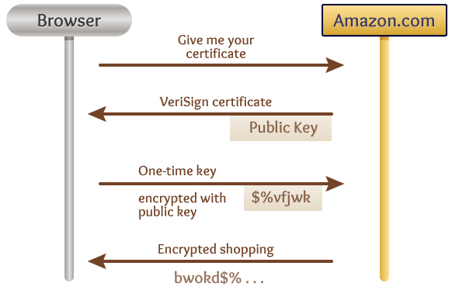
Your browser handles the security job for you!

Slide 18
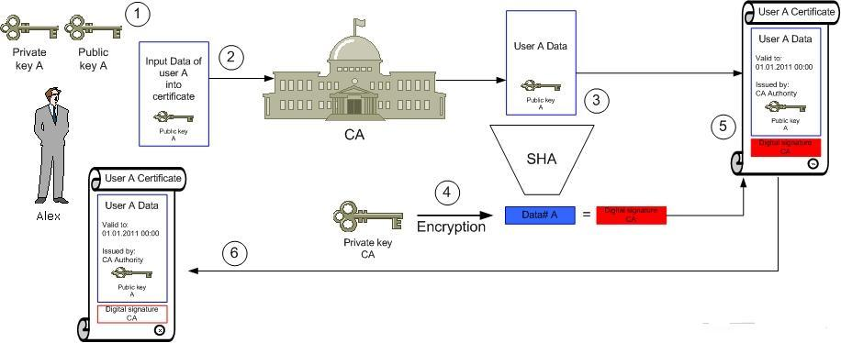
Getting a certificate

Slide 19
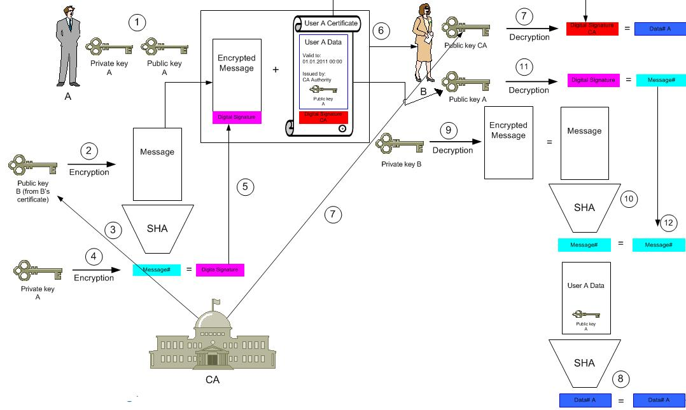
The complete process

Slide 20
Internet X.509 Public Key Infrastructure
“When a certificate is issued, it is expected to be in use for its entire validity period. However, various circumstances may cause a certificate to become invalid prior to the expiration of the validity period.

Slide 21
Internet X.509 Public Key Infrastructure
“Such circumstances include change of name, change of association between subject and CA (e.g., an employee terminates employment with an organization), and compromise or suspected compromise of the corresponding private key. Under such circumstances, the CA needs to revoke the certificate.”

Slide 22
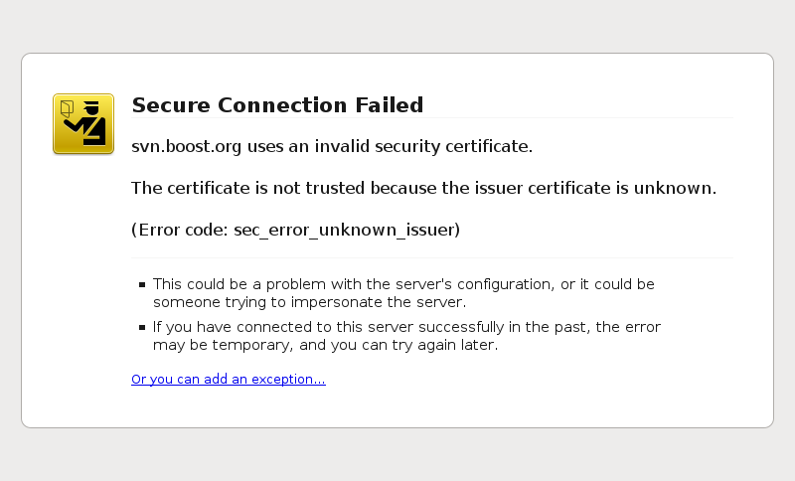
Did this ever happen to you?

Slide 23
More on Nonrepudiation
If Bob signs a document with his secret key, what is to stop him from later changing his public key and denying the signature?
Conversely, how can Bob prove that it was not his key that was used?

Slide 24
More on Nonrepudiation
Certificate Authority needs to keep records, including time stamped certificates and dates of revocations.
CA needs to be a trusted party. Can have multiple CA’s.
CA must protect its secret key.
Issued keys must be sound.

Slide 25
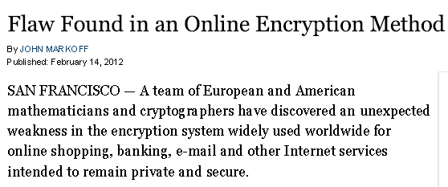
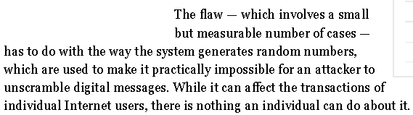
OOPS!

Slide 26
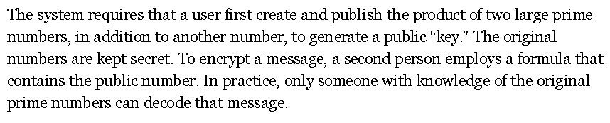
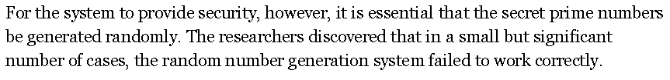
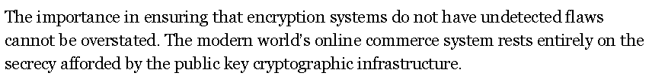
OOPS!

